Slide 1

Data science captsone project
Javier Pérez Aguirre

Slide 2
Outline
Executive Summary
Introduction
Methodology
Results
Conclusion
Appendix

Slide 3
Executive Summary
SpaceX reuses the first stage booster to lower the total cost of launching a payload to orbit.
The goal is to predict whether if the landing is going to be successful or not using different features such as orbit type and payload mass.
It was found that as more launches are done, the higher is the success rate of the booster.
The best algorithm to predict the landing outcome of the rocker booster was Decision Tree.

Slide 4
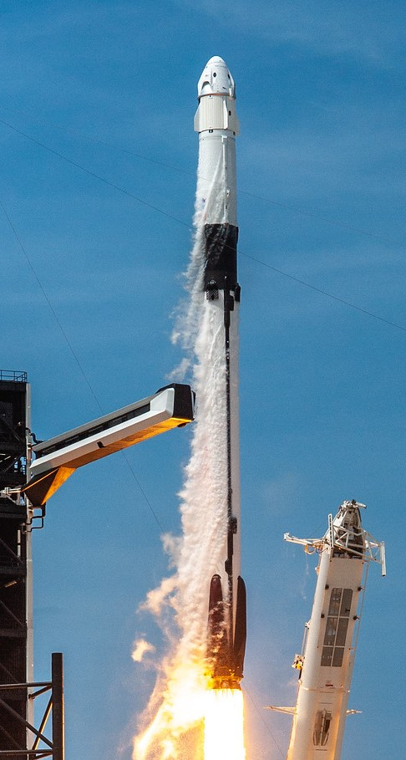
Introduction
Falcon 9 is the world's first orbital class reusable rocket. Reusability allows SpaceX to refly the most expensive parts of the rocket, which in turn drives down the cost of space access.
The rocket has been used to launch a wide variety of payloads, including satellites, the Dragon spacecraft, and the Crew Dragon spacecraft. It has also been used to launch the first commercial crewed spacecraft to the International Space Station.
They key objective of this project is to analyze and predict whether If the first stage is going to land successfully, using different features such as orbit and payload mass.

Slide 5
Methodology

Slide 6
Methodology
Data collection methodology:
SpaceX API
Web Scraping from Wikipedia
Perform data wrangling
Dropping unnecessary columns
One Hot Encoding categorical variables
Perform exploratory data analysis (EDA) using visualization and SQL
Perform interactive visual analytics using Folium and Plotly Dash
Perform predictive analysis using classification models

Slide 7
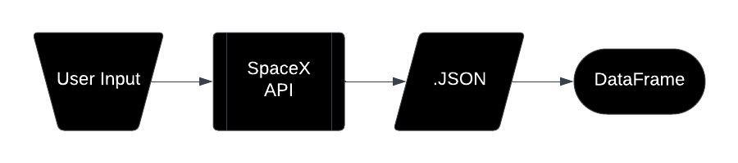
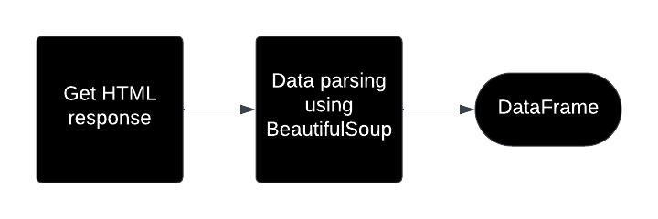
Data Collection
Data was collected using two methods: SpaceX API and Web scrapping
SpaceX API:
Web scrapping:

Slide 8
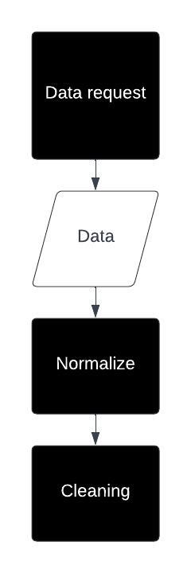

Data Collection – SpaceX API
Data request to SpaceX API:
Normalize data into a data frame:
Data cleaning: Replacing NaN values with means for the Payload Mass column
Github: https://github.com/crimpydude/Capstone-Project/blob/main/jupyter-labs-spacex-data-collection-api.ipynb

Slide 9
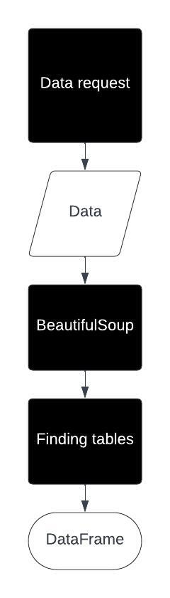
Data Collection - Scraping
Assign response to an object:
Create BeautifulSoup object:
Extract tables:
Github: https://github.com/crimpydude/Capstone-Project/blob/main/jupyter-labs-webscraping.ipynb

Slide 10
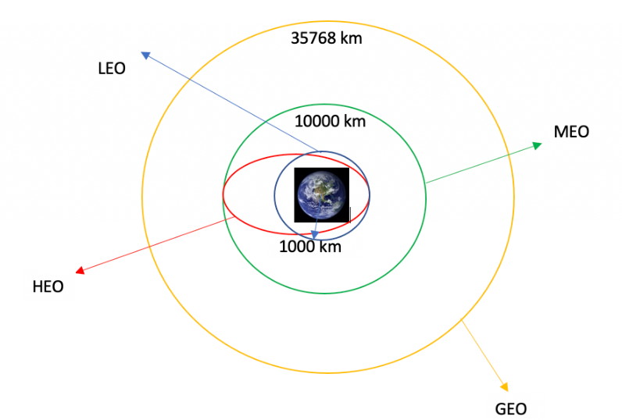


Data Wrangling
The number of launches is calculated for each site:
Number and occurrence for each orbit is calculated:
Number and occurrence of mission outcomes for each orbit:
A new column "Class" is created. Successful landings are labeled as 1 and 0 for unsuccessful landings.
Github: https://github.com/crimpydude/Capstone-Project/blob/main/labs-jupyter-spacex-Data%20wrangling.ipynb

Slide 11
EDA with Data Visualization
Scatter Plots:
Payload Mass vs. Flight Number
Launch Site vs. Flight Number
Launch Site vs. Launch Site
Orbit vs. Flight Number
Orbit vs. Payload Mass
Bar Plots:
Class mean vs. Orbit
Line Plots:
Class vs. Year
Github: https://github.com/crimpydude/Capstone-Project/blob/main/jupyter-labs-eda-dataviz.ipynb
Scatter plots show the relationship or correlation between the two variables.
Bar plots make a visually easy comparison between many variables at the same time.
And line plots are useful to identify trends of a variable over time.

Slide 12
EDA with SQL
Display the names of the unique launch sites in the space mission
Display 5 records where launch sites begin with the string 'CCA'
Display the total payload mass carried by boosters launched by NASA (CRS)
Display average payload mass carried by booster version F9 v1.1
List the date when the first successful landing outcome in ground pad was achieved
List the names of the boosters which have success in drone ship and have payload mass greater than 4000 but less than 6000
List the total number of successful and failure mission outcomes
List the names of the booster_versions which have carried the maximum payload mass. Use a subquery
List the records which will display the month names, failure landing_outcomes in drone ship ,booster versions, launch_site for the months in year 2015
Rank the count of landing outcomes (such as Failure (drone ship) or Success (ground pad)) between the date 2010-06-04 and 2017-03-20, in descending order
Github: https://github.com/crimpydude/Capstone-Project/blob/main/jupyter-labs-eda-sql-coursera_sqllite.ipynb

Slide 13
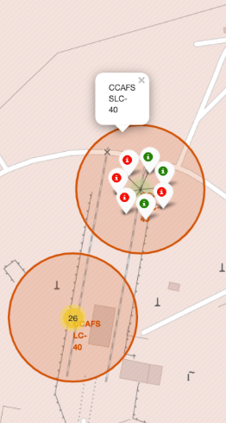
Build an Interactive Map with Folium
Launch sites were marked in a map to visually identify their location.
Green and red markers are used to represent the outcome for missions, where green is successful and red unsuccessful.
Different distances are calculated from launch sites and landmarks in the surroundings.
Github: https://github.com/crimpydude/Capstone-Project/blob/main/lab_jupyter_launch_site_location.ipynb

Slide 14
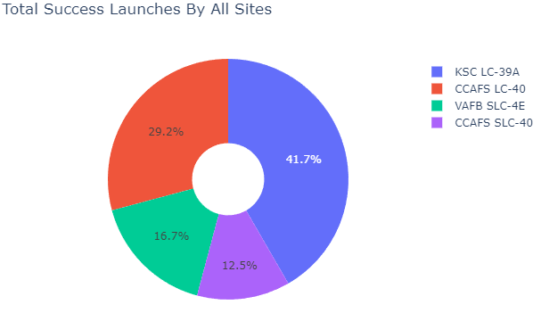
Build a Dashboard with Plotly Dash
The following plots were added to the dash:
Pie Chart of total launches by launch site
Scatter plot of Class vs. Payload Mass for different Booster
Pie Charts allow to visualize the outcome of missions per launch site.
The scatter plot helps to understand the relationship between the two variables.
Github: https://github.com/crimpydude/Capstone-Project/blob/main/spacex_dash_app.py

Slide 15
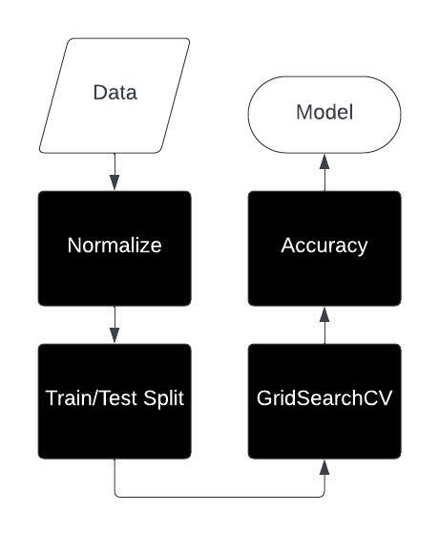
Predictive Analysis (Classification)
Data is normalized to avoid problems of data scale.
Dataset is divided into train and test set for model training and evaluation.
Once a model is chosen, a GridSearchCV object is created for parameter tunning.
Accuracy of the model is evaluated using the test set
Github: https://github.com/crimpydude/Capstone-Project/blob/main/SpaceX_Machine_Learning_Prediction_Part_5.jupyterlite.ipynb

Slide 16
Results
Exploratory data analysis results
Interactive analytics demo in screenshots
Predictive analysis results

Slide 17
Insights drawn from eda

Slide 18
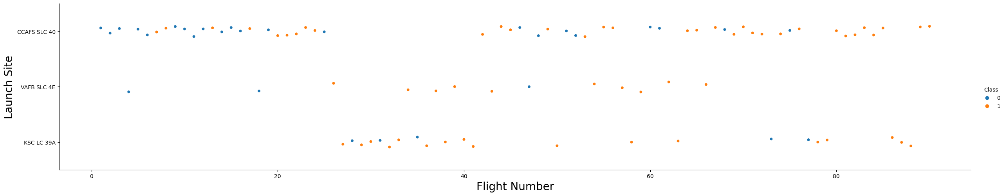
Flight Number vs. Launch Site
As the flight number increases, the successful landings are more common.

Slide 19
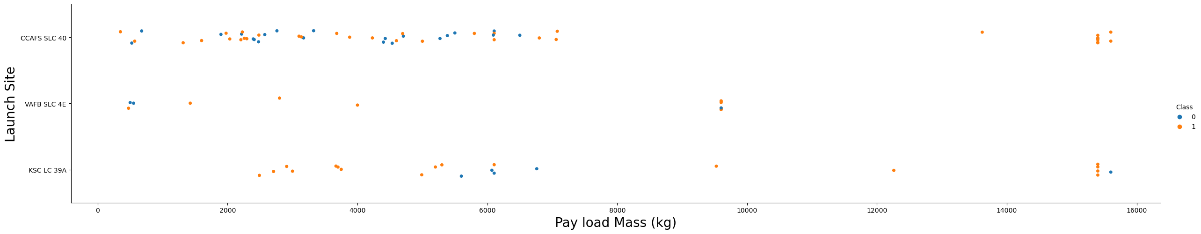
Payload vs. Launch Site
There is no apparent correlation for lighter Payloads but for heavier Payloads the success rate increases.

Slide 20
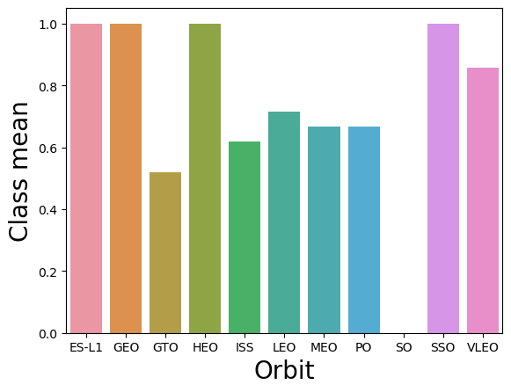
Success Rate vs. Orbit Type
ES-L1, GEO, HEO and SSO have a 100% of success rate. Meanwhile SO has a 0%.

Slide 21
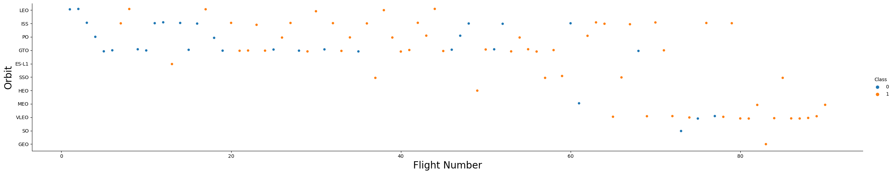
Flight Number vs. Orbit Type
In the LEO orbit the Success appears related to the number of flights; on the other hand, there seems to be no relationship between flight number when in GTO orbit.

Slide 22
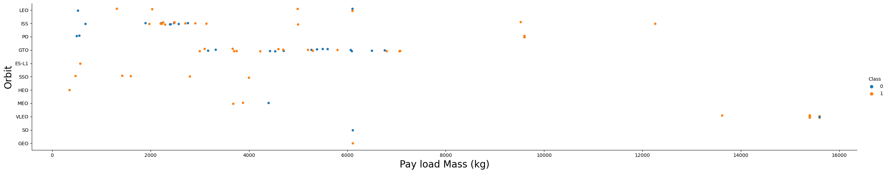
Payload vs. Orbit Type
With heavy payloads the successful landing or positive landing rate are more for Polar, LEO and ISS. However for GTO cannot be distinguished this well as both positive landing rate and negative landing (unsuccessful mission) are both there here.

Slide 23
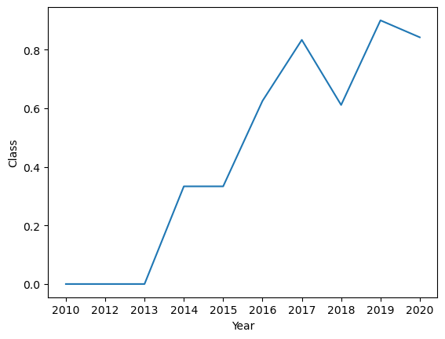
Launch Success Yearly Trend
Success rate increases from 2013 to 2020, having a small decline in 2018.

Slide 24
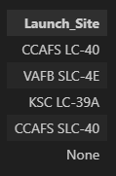
All Launch Site Names
Query: %sql SELECT DISTINCT Launch_Site FROM SPACEXTBL
The statement DISTINCT is used to get unique results from the data

Slide 25
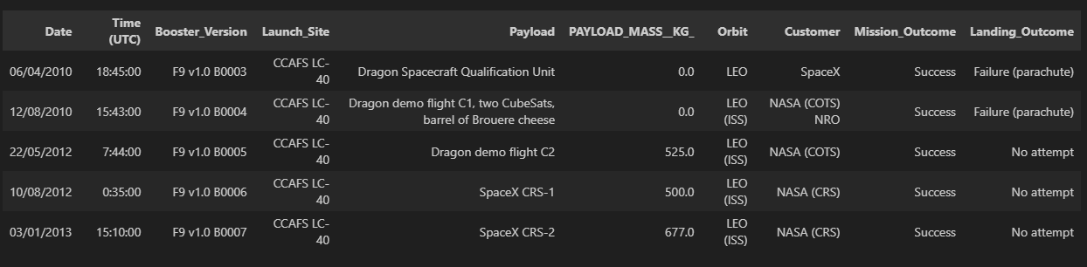
Launch Site Names Begin with 'CCA'
Query: %sql SELECT * FROM SPACEXTBL WHERE Launch_Site LIKE 'CCA%' LIMIT 5
The statement LIMIT is used to limit the results to 5.

Slide 26
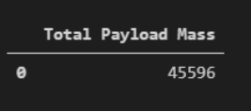
Total Payload Mass
Query: %sql SELECT SUM(PAYLOAD_MASS__KG_) FROM SPACEXTBL WHERE CUSTOMER = 'NASA (CRS)'
Data is filtered with a WHERE statement.

Slide 27

Average Payload Mass by F9 v1.1
Query: %sql SELECT AVG(PAYLOAD_MASS__KG_) FROM SPACEXTBL WHERE BOOSTER_VERSION = 'F9 v1.1'
A WHERE statement is used to filter data for booster F9 v1.1

Slide 28

First Successful Ground Landing Date
Query: %sql SELECT MIN(DATE) FROM SPACEXTBL WHERE Landing_Outcome = 'Success (ground pad)' GROUP BY DATE
Here data is grouped by date and filtered by landing outcome. The first successful landing corresponds to the date 22/12/2015.

Slide 29
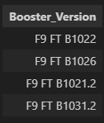
Successful Drone Ship Landing with Payload between 4000 and 6000
Query: %sql SELECT Booster_Version FROM SPACEXTBL WHERE Landing_Outcome = 'Success (drone ship)' AND PAYLOAD_MASS__KG_ BETWEEN 4000 AND 6000
Data is filtered using a BETWEEN statement for PAYLOAD_MASS__KG_

Slide 30
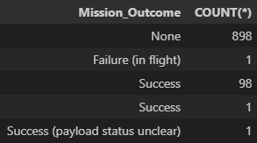
Total Number of Successful and Failure Mission Outcomes
Query: %sql SELECT Mission_Outcome , COUNT(*) FROM SPACEXTBL GROUP BY Mission_Outcome
Here the different Mission Outcomes is displayed, for a total of a 100 successful launches and 1 as a failure.

Slide 31
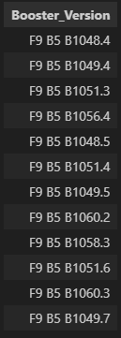
Boosters Carried Maximum Payload
Query: %sql SELECT Booster_Version FROM SPACEXTBL WHERE PAYLOAD_MASS__KG_ = (SELECT MAX(PAYLOAD_MASS__KG_) FROM SPACEXTBL)
A subquery is used to select the maximum payload: SELECT MAX(PAYLOAD_MASS__KG_) FROM SPACEXTBL

Slide 32

2015 Launch Records
Query: %sql SELECT Date, Booster_Version, Launch_Site, Landing_Outcome FROM SPACEXTBL WHERE Landing_Outcome = 'Failure (drone ship)' AND Date LIKE '%/2015'
Data is filtered where the landing outcome is faliure for Drone Ship within the year 2015.

Slide 33
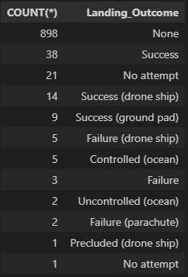
Rank Landing Outcomes Between 2010-06-04 and 2017-03-20
Query: %sql SELECT COUNT(*), Landing_Outcome FROM SPACEXTBL GROUP BY Landing_Outcome ORDER BY COUNT(*) DESC
Data is ordered by COUNT(*) DESC to get a descending list.

Slide 34
Launch Sites proximities analysis

Slide 35
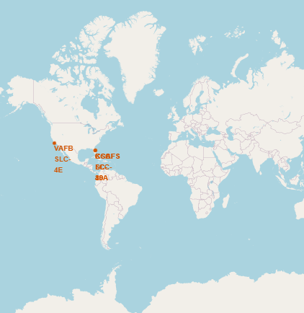
World Map and Launch Sites
Launch sites are located in the United States in both West and East coasts. All sites are located close to the equator.

Slide 36
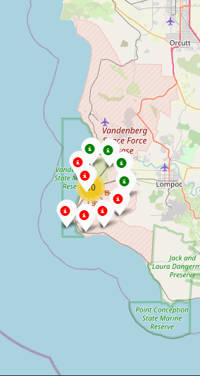
Colored labeled markers
Markers where assigned for different outcomes of missions where green is successful and red is failure.

Slide 37
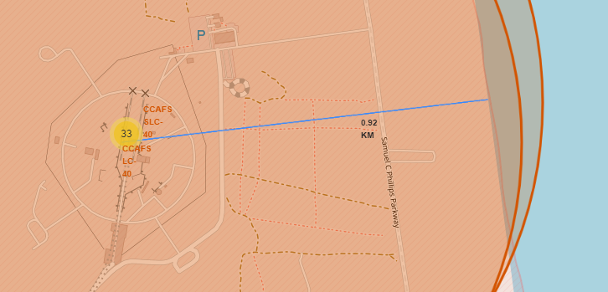
Launch Site distance from Coastline
Distances from the launch site to different landmarks is calculated.
In this slide, the distance from the coastline is shown.

Slide 38
Build a dashboard with plotly dash

Slide 39
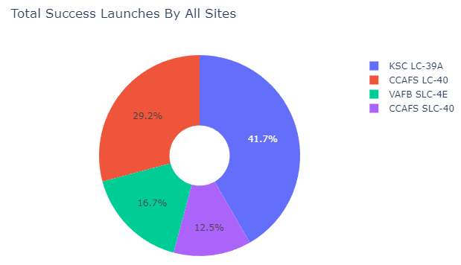
Success launches by all Sites
KSC LC-39A is the most successful site.

Slide 40
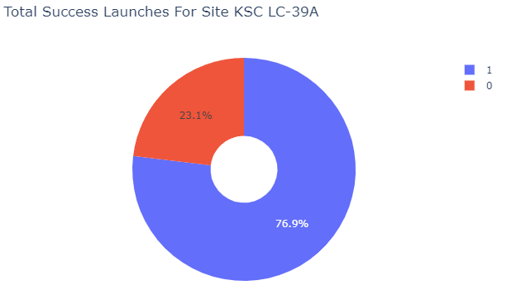
Site with highest success ratio
KSC LC 39-A has a 76.9% success rate.

Slide 41
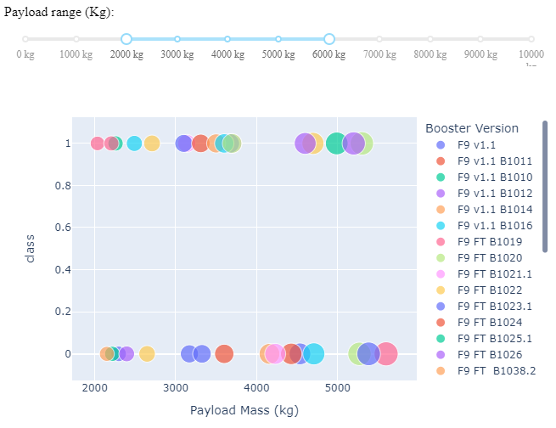
Class vs. Payload Mass
Payloads between 2000 and 6000 [kg] success rates.

Slide 42
Predictive analysis - classification

Slide 43
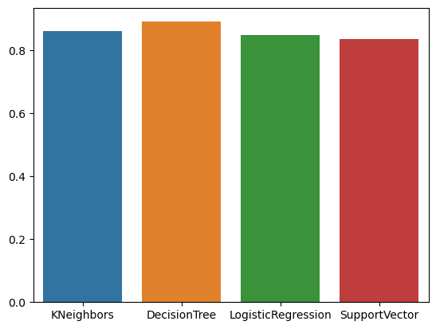
Classification Accuracy
Decision Tree has the highest accuracy with 89% approximately.

Slide 44
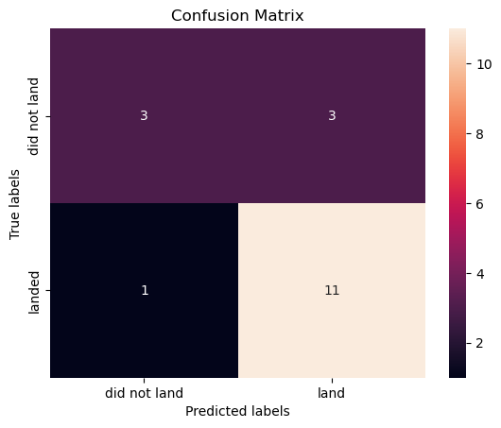
Confusion Matrix for Decision Tree
For this algorithm 4 entries were labeled wrong: 1 as did not land but landed and 3 that landed and did not land.

Slide 45
Conclusions
As more launches happen, the success rate increases.
KSC LC-39A is the most successful site.
Success rate increases from 2013 to 2020, having a small decline in 2018.
ES-L1, GEO, HEO and SSO have a 100% of success rate. Meanwhile SO has a 0%.
Decision Tree was the best algorithm for the dataset.

Slide 46
Appendix
The bar plot for the accuracy of the models was not part of the tasks. The following code will perform the plot:
models = {'KNeighbors':knn_cv.best_score_,
'DecisionTree':tree_cv.best_score_,
'LogisticRegression':logreg_cv.best_score_,
'SupportVector': svm_cv.best_score_}
algo = max(models, key=models.get)
print('Best model is', algo,'with a score of', models[algo])
sns.barplot(pd.DataFrame(models, index = [0]))

